Slide 1
HIV & Anesthesia
BIRUK T. (Bsc, Msc, CAPS)

Slide 2
HIV
HIV is a single-stranded RNA virus of the lentivirus subfamily of the retrovirus family
Two subtypes have been identified - HIV-1 and HIV-2
HIV contains the enzyme reverse transcriptase that enables viral RNA to be transcribed to DNA
Incorporate into the host cell genome & is able to replicate freely
Inhibition of this viral replication process is the target of ART

Slide 3
HIV
HIV infects T helper lymphocytes (CD4 T cells)
Cause progressive quantitative and qualitative destruction:
Making the host more susceptible to opportunistic infections & malignancies

Slide 4
Mode of transmission
Sexual intercourse (60-70%)
Mother to child –pregnancy, labor & breast feeding (20-30%)
Contaminated blood, blood products & organ donations (3-5%)
Contaminated needles (2-3%)

Slide 5
HIGH RISK GROUP
High-risk groups including:
Promiscuous hetero- & homosexuals
Patients with other sexually transmitted diseases
Intravenous drug users
Haemophiliacs
Patients from endemic areas

Slide 6
DIAGNOSIS
HIV infection is classified according to its associated clinical symptoms
The severity of immunological depression reflected by age related CD4+ T cell counts also used
The diagnosis of advanced HIV infection is made when the patient is in stage 3 or 4 and/or has advanced immunodeficiency
Severe clinical conditions and/or severe immunodeficiency are known as AIDS

Slide 7
history
History of ART therapy
History of opportunistic infection & antiopportunistic drugs
CBC, clotting functions, glucose, LFT & RFT
Verification of the immunological status i.e. the CD4+ lymphocyte cell count and viral load during 3 months

Slide 8
immunosuppression
Possible effect of GA & opioid on the immune system
Pulmonary & neurologic status of HIV patients
Interaction of anesthetic agent & RVI medications
GA & oxidants have negative effect on immune function
Immuno-suppressant effect of GA occurs starting from 15 mins to 3 up to eleven days
Postoperative immunosuppression lasts longer in inherently immunosuppressed patients
Predispose to postoperative infection & tumor growth & metastasis

Slide 9
investigations
CD4 count and viral load in the past 3 months
Chest radiograph & ECG for all patients
Signs of cardiac & pulmonary dysfunction – ABG & Echocardiography
Patients are exposed to cardiotoxic antiretroviral drugs
Patients are in hypercoagulable state
Decreased left ventricular function
Accelerated coronary atherosclerosis

Slide 10
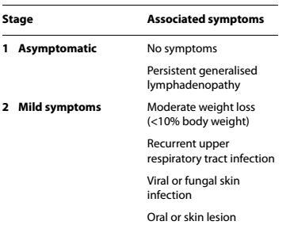
Clinical stages of hiv

Slide 11
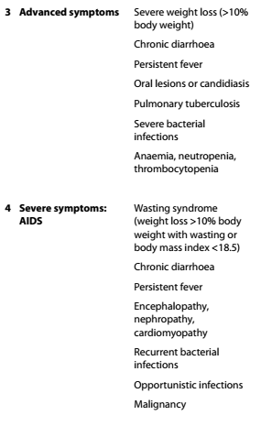

Slide 12
Systematic effect of HIV CVS
Pericardial, myocardial, endocardial or vascular lesions, as well as neoplasm
Dilated cardiomyopathy
Pericardial effusions
Endocarditis and valvular lesions
Acute coronary syndrome
Vasculitis
Pulmonary hypertension.

Slide 13
RESPIRATORY SYSTEM
Both the upper and lower airway can be involved
Airway obstruction (by Kaposi sarcoma or infections)
Bronchitis
Sinusitis
Pneumonia
Pneumonitis
Atypical infections (commonly tuberculosis, other mycobacteria & fungal infections)

Slide 14
GASTROINTESTINAL SYSTEM
Difficulty or pain on swallowing
Increased gastric emptying times
Bleeding tendency on airway instrumentation/NGT insertion
Diarrhea with associated electrolyte dysfunction & dehydration
Hepatobiliary impairment
Pancreatitis

Slide 15
RENAL SYSTEM
Acute & chronic renal disease can be associated with HIV
The causes of renal impairment can be multifactorial:
Drug-induced nephrotoxicity, hypertension & diabetes
HIV-associated nephropathy
ADJUSTMENT
Avoidance of nephrotoxic drugs
Dose adjustment of renally excreted drugs
The need for adequate hydration to prevent further deterioration of renal function

Slide 16
Neurological system
The cause for neurological involvement:
Direct infection
Inflammation
Demyelination or a degenerative process
Opportunistic infections
Neoplasms
Immune deficiency

Slide 17
Neurological system
This can involve all structures including the meninges, brain, spinal cord, peripheral nerve or muscle
Neurocognitive impairment
Encephalopathy
Autonomic neuropathy
Seizures
Complete neurological exam & record findings specially for regional anesthesia

Slide 18
Hematological system
Anemia
Neutropenia
Thrombocytopenia
Persistent generalized lymphadenopathy
Hematological malignancies
Coagulation abnormalities

Slide 19
Endocrine & metabolic system
Lipodystrophy (truncal obesity, buffalo hump, peripheral wasting)
Metabolic syndrome (raised plasma triglycerides, cholesterol, glucose)
Disorders of the hypothalamic–pituitary–adrenal axis including
Cushing’s syndrome and Addison’s disease
Hyponatremia due to syndrome of inappropriate antidiuretic

Slide 20
Endocrine & metabolic system
Hormone or adrenal failure
Hypo- or hyperthyroidism
Lactic acidosis

Slide 21
ART
Adherence to ART is of paramount importance
Adherence < 95% being associated ↑ in viral load & drug resistance
This naturally has implications for interruption of ART therapy due to perioperative fasting
Fasting times should be kept to an absolute minimum

Slide 22
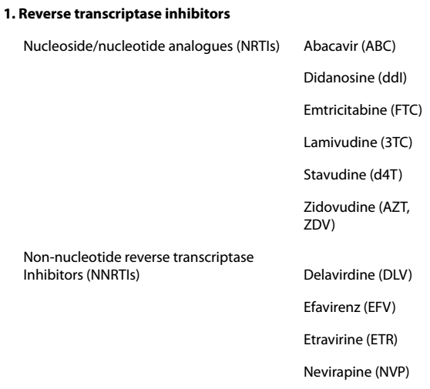
art

Slide 23
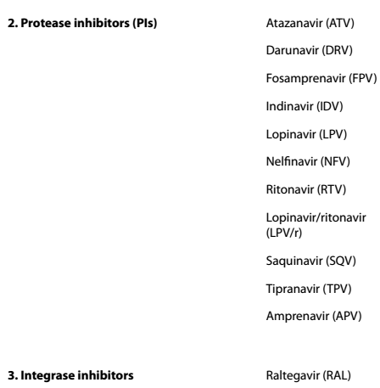
ART

Slide 24
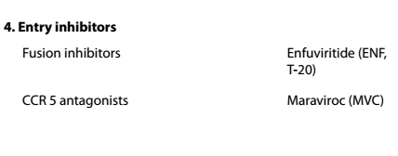
ART

Slide 25
SIDE EFFECT
Classified into four groups:
Mitochondrial dysfunction:
Lactic acidosis
Hepatic toxicity
Pancreatitis
Peripheral neuropathy

Slide 26
Side effects
Bone marrow suppression:
Anemia
Neutropenia
Thrombocytopenia
Allergic reactions:
Skin rashes and
Hypersensitivity responses

Slide 27
Metabolic abnormalities:
Fat maldistribution
Change in body habitus
Dyslipidemia
Hyperglycemia
Insulin resistance
Bone disorders e.g. osteopenia, osteoporosis and osteonecrosis

Slide 28
Drug interaction
Halothane or methoxyflurane cause hepatic or renal dysfunction
Propofol and NRTIs may both potentially promote mitochondrial toxicity & lactic acidosis
Avoid propofol infusions in patients receiving ART
Protease inhibitors (PIs) and NNRTIs are the most commonly implicated group of ARTs in drug interactions
Enzyme induction or inhibition can affect the action of several classes of anesthetic drugs

Slide 29
Drug interaction
Opioids
The effects of fentanyl may be enhanced by ritonavir due to both liver enzyme inhibition and induction
Enzyme inhibition reduces fentanyl clearance & enzyme induction
Increases metabolism to active metabolites such as pethidine
Benzodiazepines
Saquinavir may inhibit midazolam metabolism

Slide 30
Drug interaction
Calcium channel blockers
may have enhanced hypotensive effects due to enzyme inhibition
Neuromuscular blocker effects may be prolonged, even a single dose of vecuronium for instance
Local anesthetics such as lidocaine may have ↑ plasma levels due to enzyme inhibition

Slide 31
It is recommended that ART therapy be continued throughout the perioperative period if at all possible
Some ARVs are available in liquid form enabling administration via feeding tube or gastrostomy
Parenteral preparations are limited to zidovudine and enfuvirtide only

Slide 32
Regional anesthesia
HIV complications may pose relative contraindications to regional anesthesia:
Myelopathy
Vertebral or spinal neoplasms
CNS infection
Coagulopathy

Slide 33
Regional anesthesia
The presence of HIV infection is not an absolute contraindication to RA
There is no evidence that HIV progression is ↑ by central neuraxial blockade
It is essential to conduct a full preoperative neurological assessment & to document any neurological deficit

Slide 34
Preoperative evaluations
A multisystem & multidisciplinary approach is recommended
Thorough preoperative assessment for status of HIV infection includes:
History, including risk factors
Physical examination
Laboratory tests
Assess organ involvement
Drug history and side effects

Slide 35
Blood transfusion
There is evidence that allogeneic blood transfusion in the HIV
Infected patient can lead to transfusion-related immunomodulation (TRIM)
Can result in Increase in HIV viral load
Blood should only be transfused where unavoidable to maintain patient safety

Slide 36
CRITICAL CARE
HIV-infected patients may require intensive care treatment
Circumstances related to HIV & for medical & surgical conditions unrelated to HIV
Overall mortality rates for HIV-infected patients requiring ICU
Improved from approximately 70% in the early 1980s to 30-40% at present
New diagnosis of HIV in the ventilated, sedated patient who is unable to consent to testing present as an ethical problem
No evidence ot the initiation of ART may improve outcome in the critically ill HIV patient

Slide 37
PAIN
Pain is common in advanced HIV disease and can be very difficult to treat
Cause of pain can be multifactorial:
Opportunistic infections such as herpes simplex
HIV-related arthralgia
Peripheral neuropathy
Drug-related pain
Can have impact also on the treatment of postoperative pain relief &
will necessitate a multimodal approach

Slide 38
The child with HIV
80% of HIV-infections in children are due to transplacental exposure to maternal HIV during the perinatal period
13% of HIV infected children are exposed during blood transfusions
5% from blood products for treatment of coagulation disorders
Pediatric AIDS is a disease of early childhood with 50% of cases displaying clinical manifestations by 1 year of age & 80% by 3 years of age

Slide 39
Clinical manifestation in children
Clinical manifestation differ from adults in different ways:
Pulmonary disease is the leading cause of morbidity & mortality
Lymphoid interstitial pneumonitis (chronic lung disease) is more common
Cardiac abnormalities are noted in both asymptomatic HIV infection as well as advanced AIDS

Slide 40
Clinical manifestation in children
Neurological abnormalities including:
Progressive encephalopathy with signs of developmental delay
Progressive motor dysfunction
Loss of milestones & behavioral changes
Opportunistic infections of the central nervous system are less common than in adult
Children with HIV often fail to thrive, primarily from chronic infectious diarrhea and mucocutaneous candidiasis in 75%
Lymphadenopathy is a common presenting feature

Slide 41
Common surgical conditions in hiv-children
Therapeutic & diagnostic procedures predominate
Central venous catheter placement
Gastrostomy tube placement
Lung and liver biopsies
Common surgical procedures of childhood such as tonsillectomy or herniorrhaphy may also be required

Slide 42
INFECTON CONTROL
Adopt universal infection control precautions for all patients
Against blood-borne infections as in areas of high HIV prevalence
Many patients will be asymptomatic and may be classified as ASA 1-2
Risk of contracting HIV over an anaesthetic career can be as high as 4.5% in areas of high prevalence

Slide 43
CAUSES OF TRANSMISSION
Needle stick injury as with hollow needles or deep punctures (transmission risk of 0.3%)
Mucocutaneous route (splashing of a mucosal surface or broken skin by body fluid)
Transmission risk 0.03%
All healthcare workers should be immunized against hepatitis B

Slide 44
precautions
Dispose of sharps safely
Do not re-sheath needles
Wear gloves
Use disposable equipment where possible
Clean reusable equipment promptly & proper

Slide 45
Post-exposure steps
FIRST AID
Needle stick or contaminated wound – encourage bleeding from the skin wound
Wash the area with copious soapy water or disinfectant
Contaminated intact skin – wash with soap and water
Contaminated eyes – gently rinse eyes while open with saline or water
Contaminated mouth – spit out any fluid, rinse the mouth with water & spit out again

Slide 46
Post-exposure steps
If the patient is known to be HIV positive - the healthcare worker should receive post-exposure prophylaxis as soon as possible
After exposure (ideally within the first 1-2hrs)
If TB is suspected or likely in a patient-the healthcare worker should wear a tight fitting facemask to reduce the risk of transmission
Ideally a high quality particulate mask if available e.g. N95 or HEPA
Anaesthetic breathing equipment should be decontaminated after use to protect future patients

Slide 47
ANESTHETIC MANAGEMENT PLAN
A multisystem and multidisciplinary approach is recommended
Thorough preoperative assessment for status of HIV infection includes:
History, including risk factors
Physical examination
Laboratory tests
Assess organ involvement
Drug history and side effects

Slide 48
INVESTIGATION
CBC
Coagulation profile (consideration of use of TEG/platelet mapping if available)
RFT, LFT, RBS, electrolyte profile
Viral load and CD4+ count
Chest radiography to screen for opportunistic infections & tuberculosis
Cardiac evaluation with ECG & echo (if possible) to screen for cardiomyopathy

Slide 49
Before induction
Possible interaction of the anesthetic agents with ART medications
Adverse effects mimic sign & symptoms of HIV
Side effect may also be caused by drugs that are used to prevent opportunistic infection
Dosing during pregnancy should consider volume of distribution & blood volume
Toxic side effects might affect the fetus & the new born
Neuropathy or myopathy may make us change plan & drugs of anesthesia

Slide 50
Preparation of or & professionals
Universal precautions with gloves, aprons, visors etc.
Sharp object collection devices with appropriate sharps handling
No re-sheathing of needles
Staff fully aware of protocols in the event of occupational exposure:
Rinse & wash affected area with soap & water
Recipient lab tests: HIV & acute hepatitis panel
Determine infectious status of source
Availability of post exposure prophylaxis to be started ASAP

Slide 51
Preparation of or & professionals
Hepatitis B immune globulin and/or hepatitis B vaccine
Achieve early identification of chronic hepatitis C disease
HIV PEP protocol with 3 or more ARTs if known HIV +VE donor or high-risk patient or with 2 or more ARTs if low risk
These ARTs are given for 4 weeks or until source person is found to be -VE for HIV
Follow up with counselling & HIV testing for at least 6 months post exposure (tests done at baseline, 6 weeks, 12 weeks & 6 months)

Slide 52
Perioperative considerations for the patient with HIV
Minimize interruptions in ART therapy as possible to diminish drug resistance
Consider drug interactions with ART with use of drugs affected by hepatic enzyme inhibition and/or induction
Strict aseptic technique to be exercised as HIV infected patients are immunocompromised & are susceptible to bacterial infections
The anaesthetic plan should be tailored to the individual patient & the type of surgery

